Slide 1
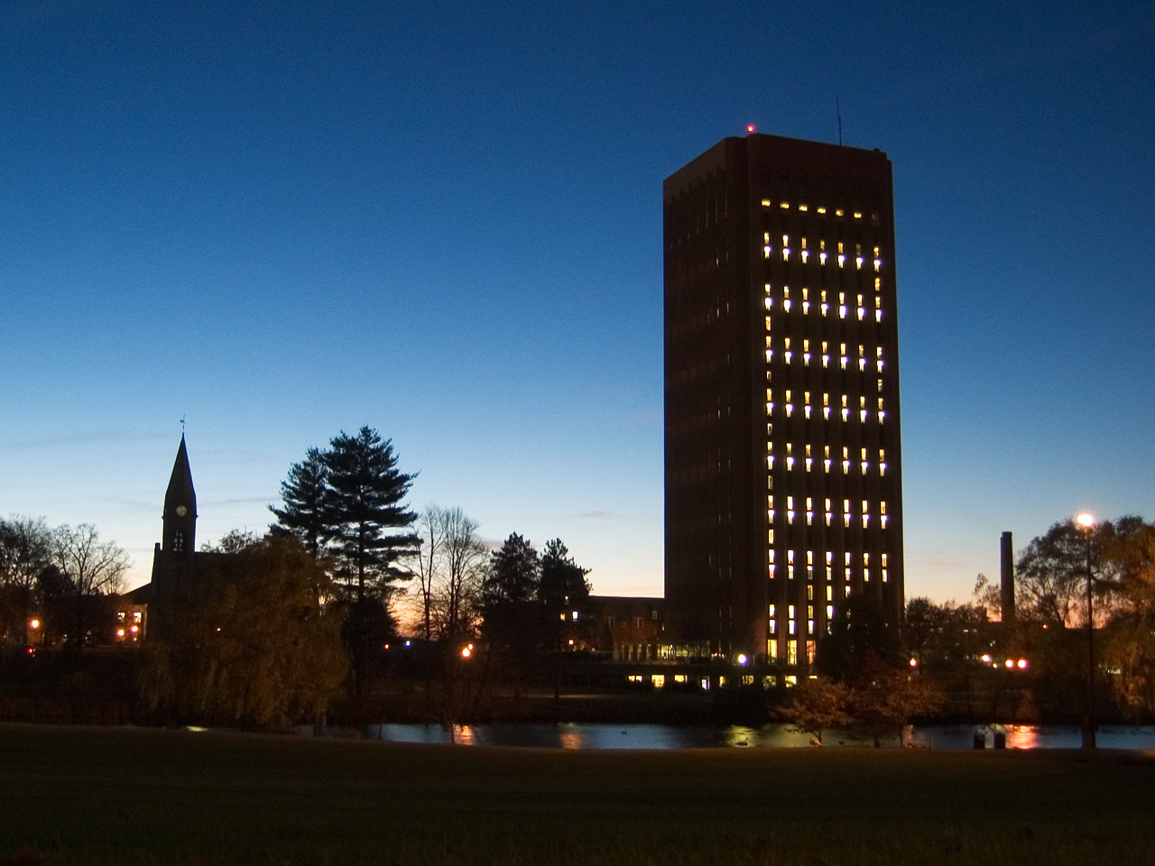
Neuroendocrine Disruptors and Brain Development: Lessons from PCBs
R. Thomas Zoeller
Department of Biology
University of Massachusetts Amherst

Slide 2
Preview
PCBs are a complex mixture (and populations are exposed to much more than just PCBs)
Some PCBs can activate cellular responses generally regarded as “detoxifying”, but this can also bioactivate some congeners.
PCBs produce a heterogeneous effect on thyroid hormone action in the developing brain.
These findings provide insight into the nature of “mixtures” and of NAMs

Slide 3
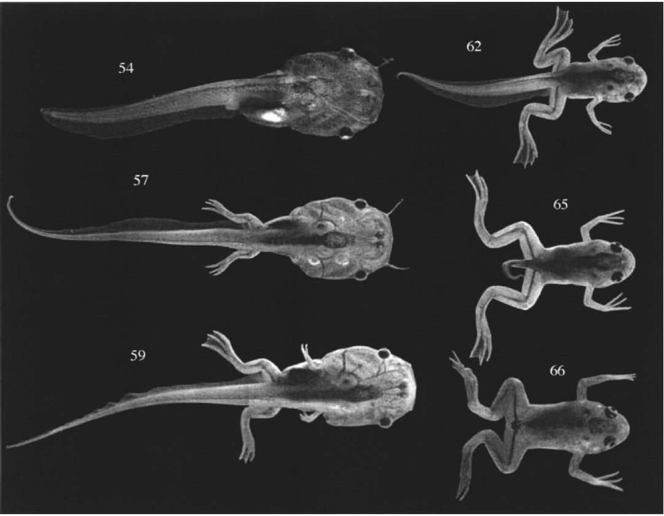

Thyroid hormone is essential for brain development
6yr
17 yr
Cretinism
From Delange, 1996
Metamorphosis
Notes:
Why is thyroid hormone system a good model for studying ED.. All vertebrate classes TH is important .. Complex system but we know a lot about it

Slide 4
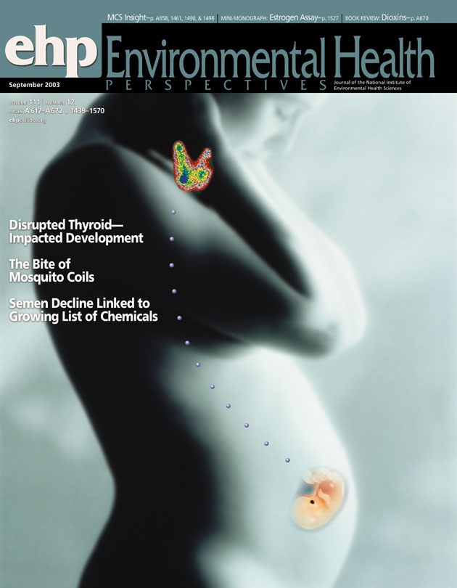
Thyroid hormone of maternal origin and the fetus
Fetal thyroid function begins around week 12 of pregnancy, but does not produce sufficient hormone until week 20. TH receptors are expressed long before this.

Slide 5
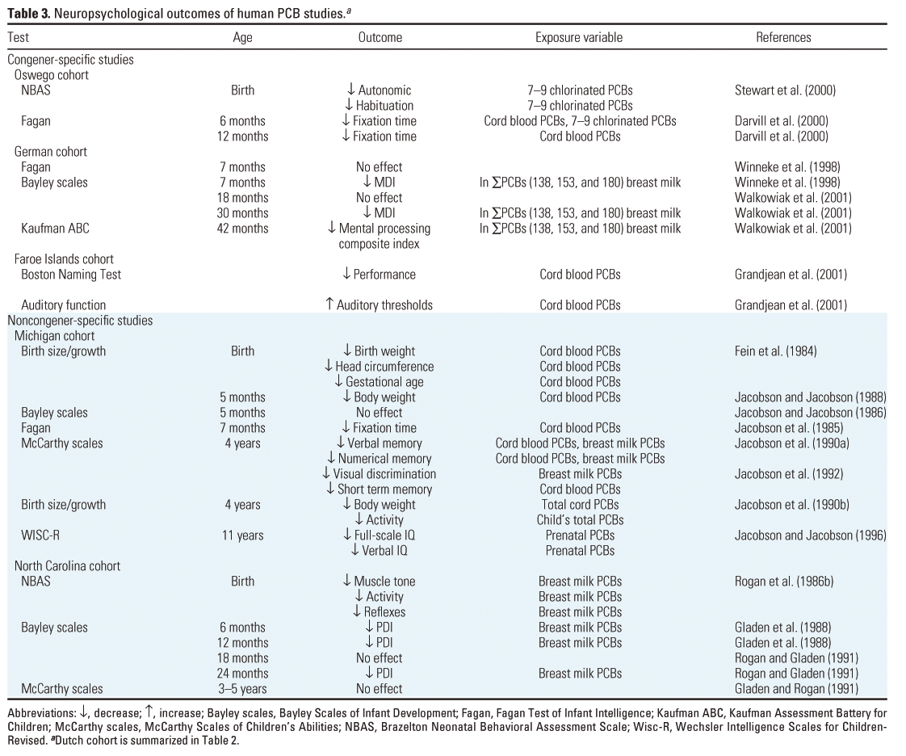
Polychlorinated Biphenyls
Many studies have identified cognitive deficits in association with PCB body burden.
Can PCBs interfere with TH signaling?
Schantz & Rice (2003) Environ Hlth Perspect 111

Slide 6
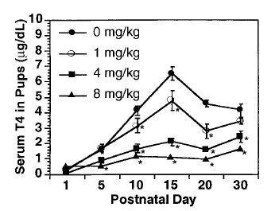
PCBs reduce serum T4
Zoeller et al., 2000 Endocrinology 141:181.

Slide 7
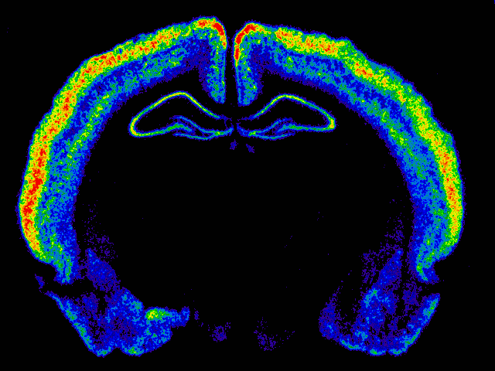
Polychlorinated Biphenyls
RC3 mRNA in Dentate
Gyrus (Density)
Cx
60
55
*
*
50
DG
45
RC3
40
35
30
25
0 mg/kg
1 mg/kg
4 mg/kg
8 mg/kg
Pseudocolor image of Autoradiogram following in situ hybridization for RC3 mRNA
A1254 Dose
Zoeller et al., 2000 Endocrinology 141:181.

Slide 8
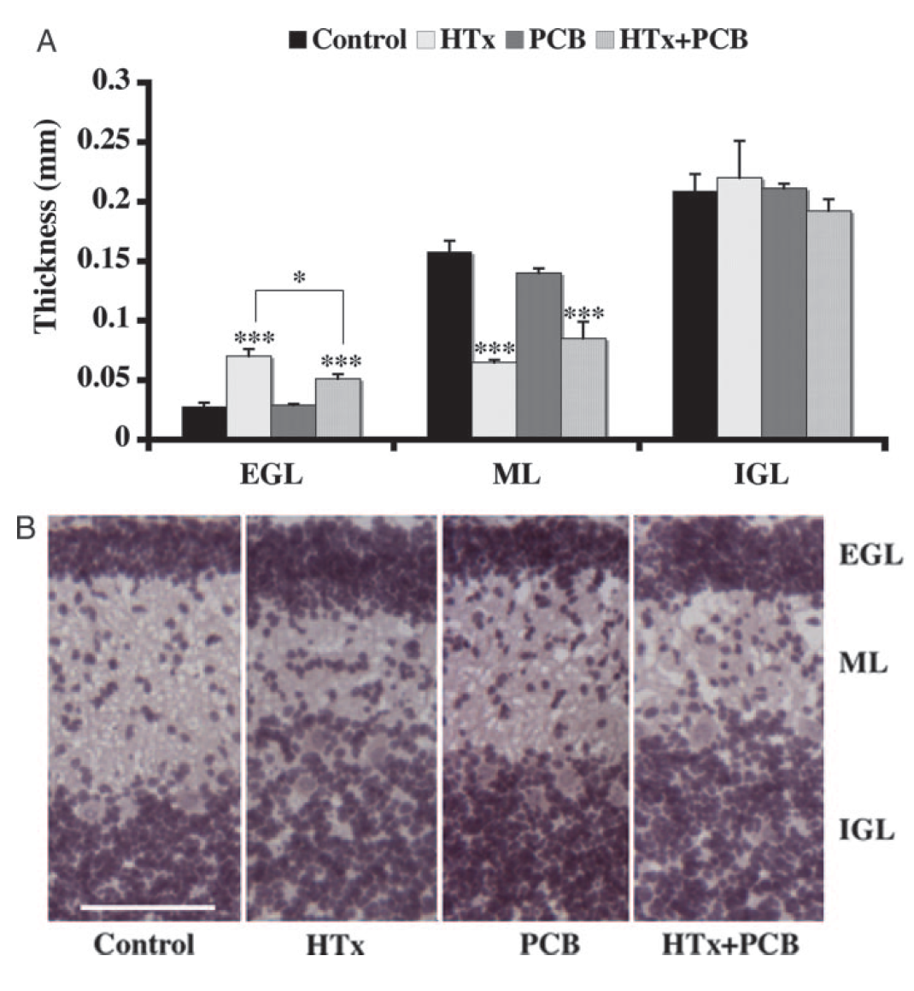
A1254 exerted different effects in different brain regions
Bansal, R., & Zoeller, R. T. (2008). Polychlorinated biphenyls (Aroclor 1254) do not uniformly produce agonist actions on thyroid hormone responses in the developing rat brain. Endocrinology, 149(8), 4001-4008.

Slide 9
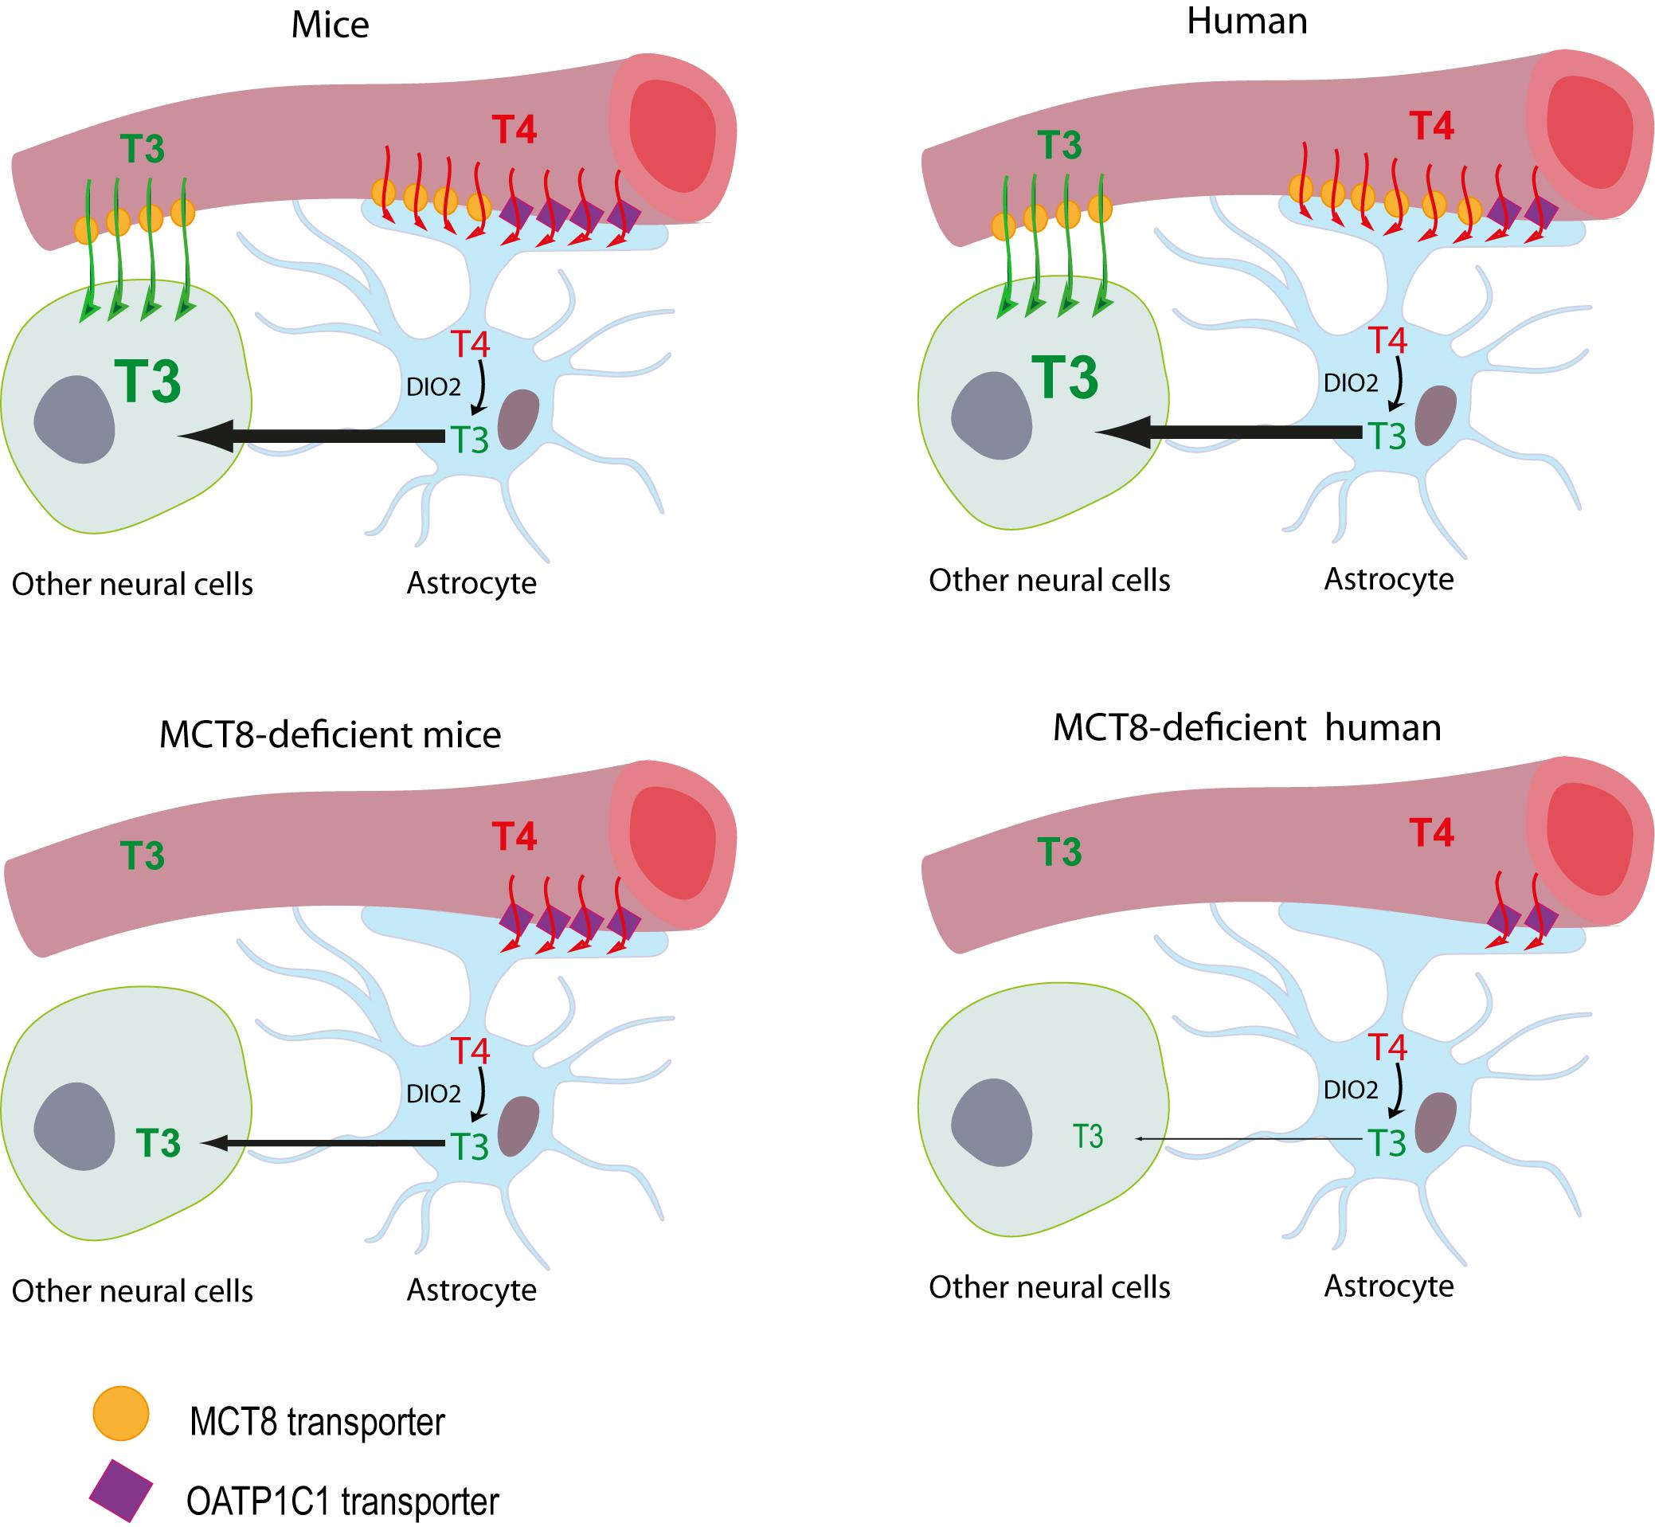
MCT8 expression in hippocampus
In the rat, MCT8 expression responds differently to low thyroid hormone in different regions of the hippocampus.
Sharlin et al., 2010. The nature of the compensatory response to low thyroid hormone in the developing brain. Journal of neuroendocrinology, 22(3), 153-165.
Grijota-Martinez, 2020 Front Neurosci, 14, 380.

Slide 10
So…
There appears to be at least three separate issues that may explain the heterogeneous effects of A1254 on the thyroid hormone system in the developing brain:
  PCBs appear to activate liver to “clear” PCBs, but in the process also reduces serum T4.
  Some congeners may act as thyroid hormone receptor agonists.
  Low serum thyroid hormone may trigger different cellular ”compensatory” responses in different brain regions.

Slide 11
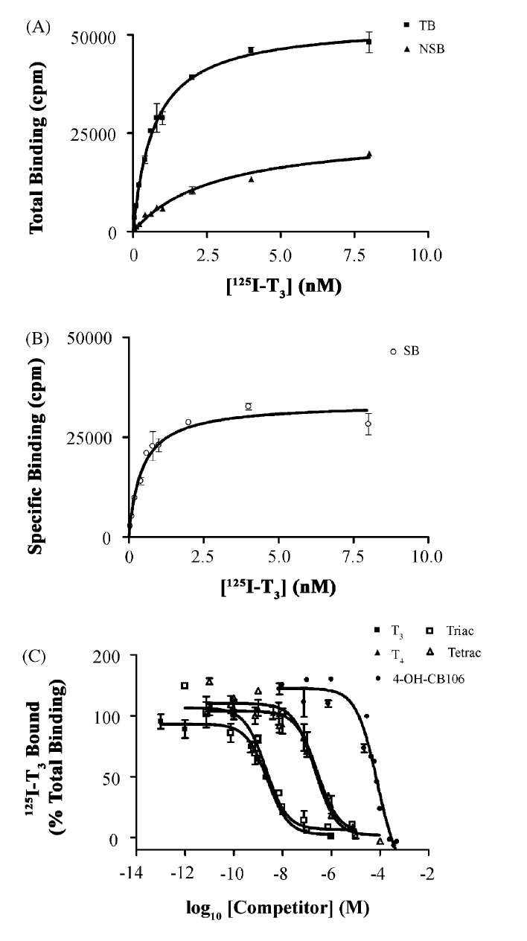
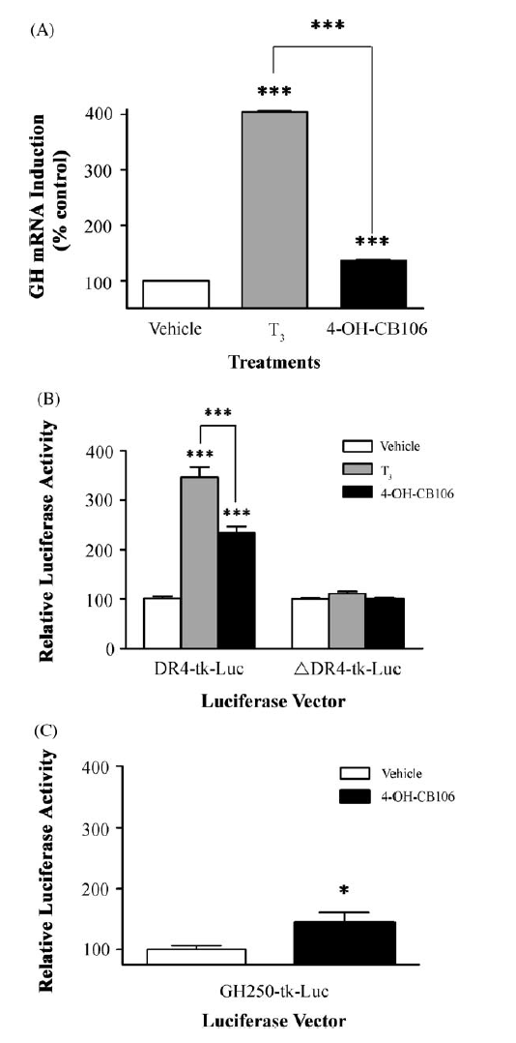
A hydroxylated PCB congener can bind to human recombinant TRβ1
You et al., 2006. Mol Cell Endocrinol, 257-258, 26-34.
Notes:
Thyroid hormone only after birth?
You aren’t giving us a good idea of why you are showing this

Slide 12
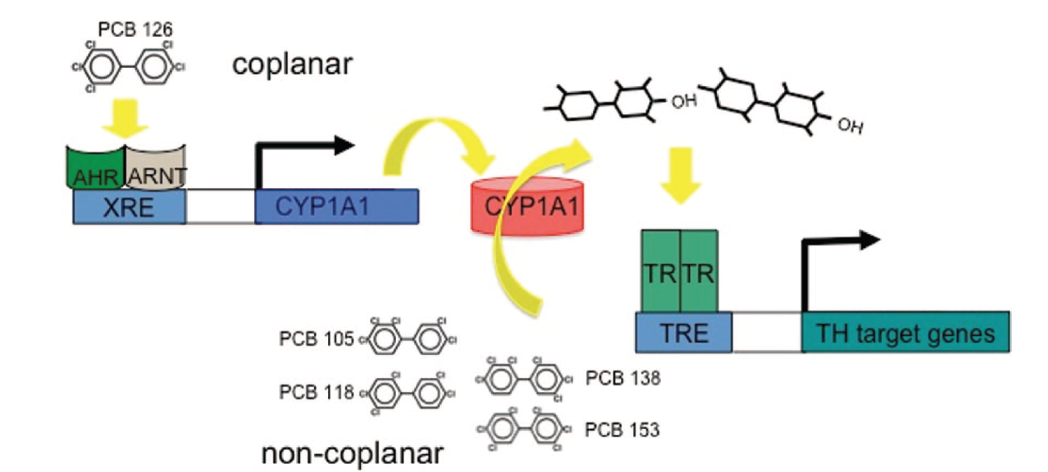
A 2-step process
Notes:
Thyroid hormone only after birth?
You aren’t giving us a good idea of why you are showing this

Slide 13
In Humans:
Placenta available from an epidemiological study
Placenta exhibits known thyroid hormone target genes
Notes:
Thyroid hormone only after birth?
You aren’t giving us a good idea of why you are showing this

Slide 14
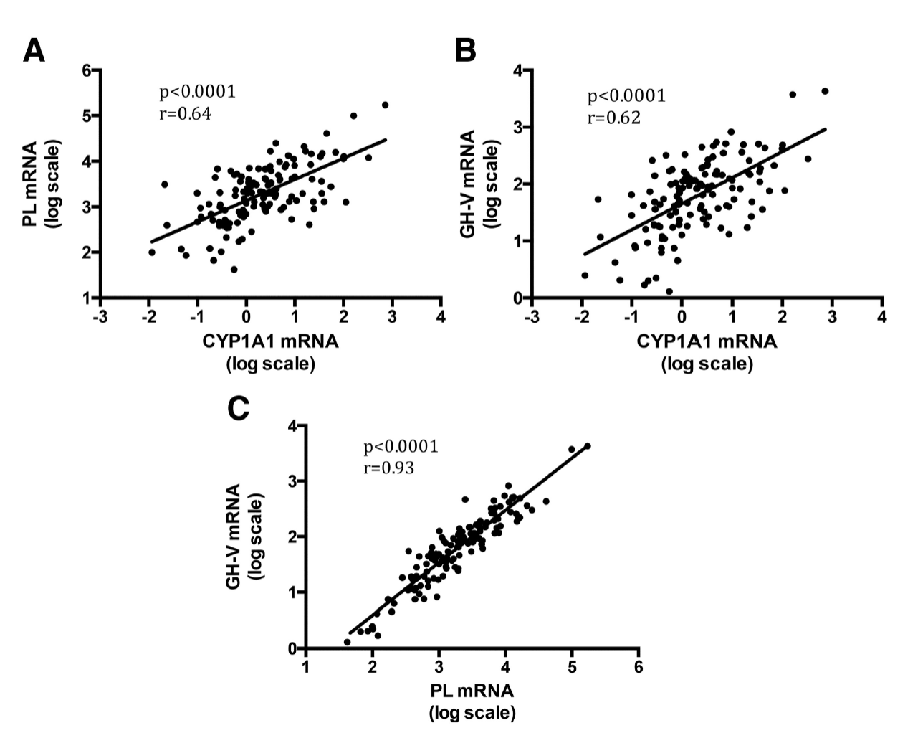
A 2-step process
Thyroid hormone target genes are tightly linked to CYP1A1 expression in human placenta.
These 2 genes are even more tightly linked to each other, suggesting a common regulatory factor.
But – the expression of these genes is not correlated with cord blood T4.
Notes:
Thyroid hormone only after birth?
You aren’t giving us a good idea of why you are showing this

Slide 15
Mixtures
Within the class of PCBs
  Some congeners induce cellular responses that can interact with other congeners to make them ”more toxic” (from an EDC point of view).
  Because there are many dioxin-like chemicals capable of inducing CYP1A1, it implicates interactions within non-class mixtures that may interact with this class (and visa versa)
Notes:
Thyroid hormone only after birth?
You aren’t giving us a good idea of why you are showing this

Slide 16
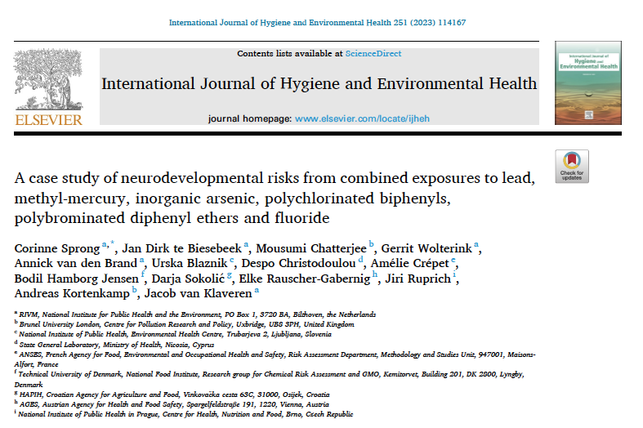
Mixtures
lead, meHg, iAs, fluoride, NDL-PCBs and PBDEs
Populations in all countries exceeded combined tolerable levels (for IQ) at median exposure levels.
Notes:
Thyroid hormone only after birth?
You aren’t giving us a good idea of why you are showing this

Slide 17
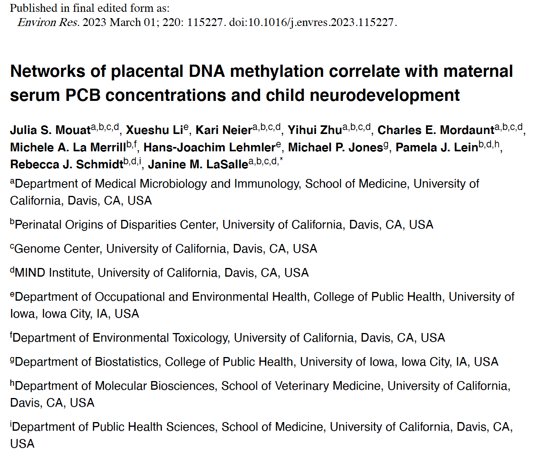
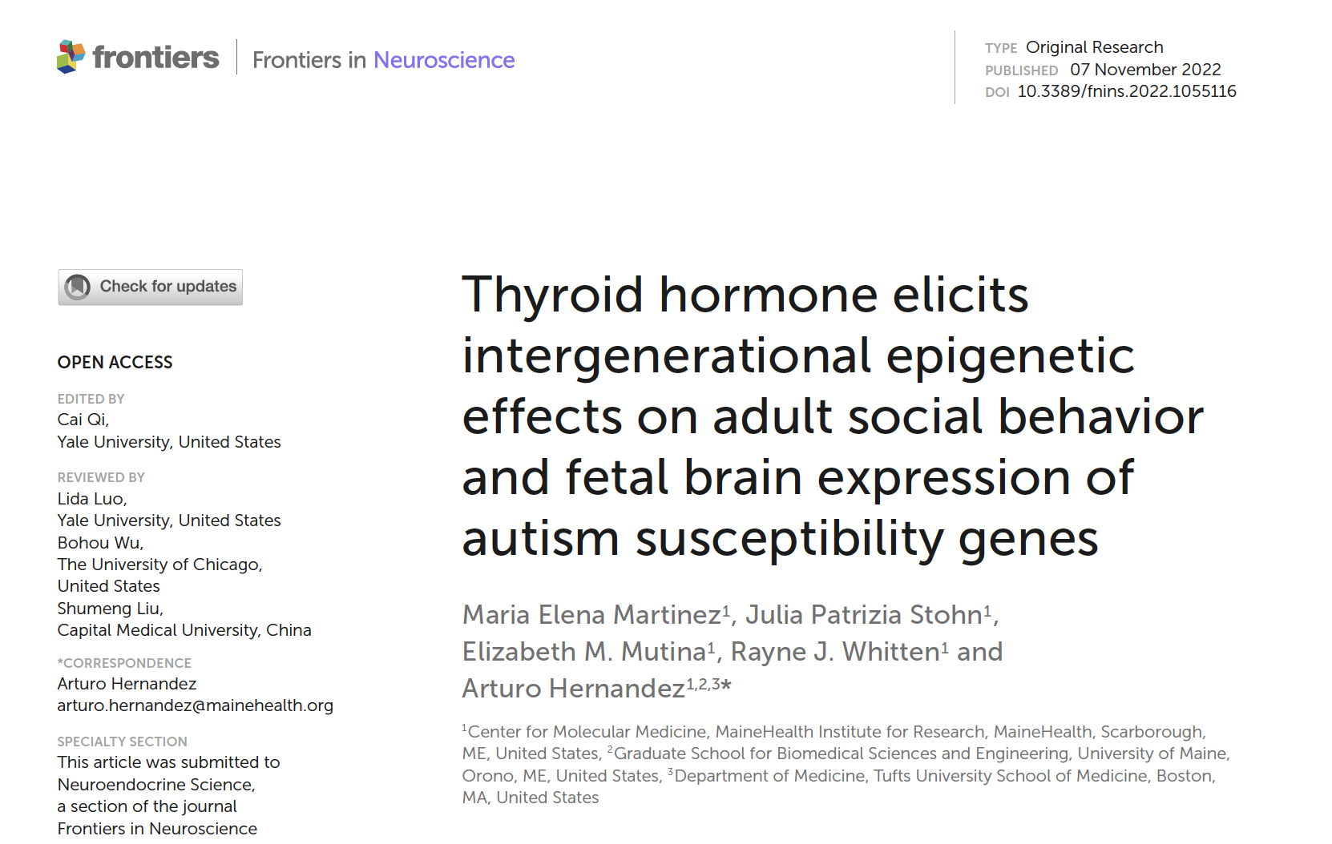
Notes:
Thyroid hormone only after birth?
You aren’t giving us a good idea of why you are showing this

Slide 18
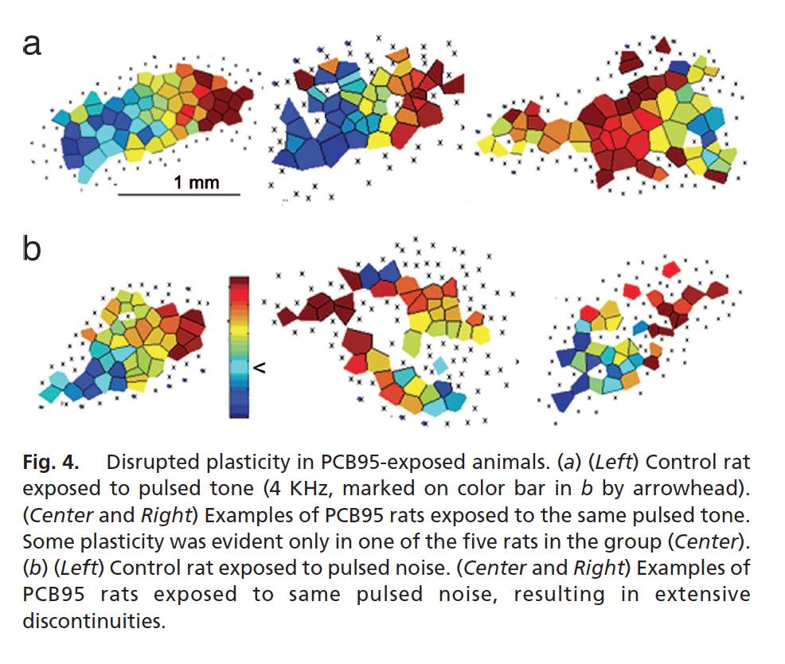
PCB95 and the Auditory Cortex
Kenet, T., Froemke, R. C., Schreiner, C. E., Pessah, I. N., & Merzenich, M. M. (2007). Proceedings of the National Academy of Sciences of the United States of America, 104(18), 7646-7651.
Notes:
Thyroid hormone only after birth?
You aren’t giving us a good idea of why you are showing this

Slide 19
Thank You
Notes:
Thyroid hormone only after birth?
You aren’t giving us a good idea of why you are showing this

